Slide 1

“IntelligentAcademicPerformance
Experiential Learning Project Assessment-II
on
Tracker & Visualizer”
under the course
Python Programming Language (N-PCCCM304P)
Presented By: Diggaj Turkar [CM25076]
Under the Guidance of
Mrs. Mayuri Getme
Session: 2026-27 (ODD)
Department of CSE(AI&ML)
S. B. JAIN INSTITUTE OF TECHNOLOGY MANAGEMENT AND RESEARCH, NAGPUR
An Autonomous Institute, Affiliated to RTMNU, Nagpur

Slide 2
Contents
Problem statement Objectives Algorithm
Flowchart / pseudocode Understanding of Python logic Graphical representation and working
GitHub account, repository creation, uploading code, meaningful commits, collaboration, individual contribution
Result / expected output
S. B. Jain Institute of Technology Management and research

Slide 3
1. Problem Statement
Students receive marks and attendance data from multiple subjects, but manually calculating grades, GPA/CGPA, attendance percentage, and performance trends can be time-consuming and error-prone.
The application should accept student academic data, calculate subject-wise grades and overall GPA/CGPA, check attendance, and present results through clear charts and graphs.
The system aims to provide a simple Python-based academic dashboard that helps students understand strengths, weak subjects, attendance status, and progress across semesters.

Slide 4
2. Objective
To develop a Python application for tracking student academic performance.
To calculate subject-wise marks, grades, grade points, and attendance percentage.
To calculate semester GPA and overall CGPA from academic records.
To identify strong and weak subjects using score comparisons. To visualize marks and performance trends using charts and graphs.
To provide a simple and understandable academic performance summary.
To practice Python data handling, functions, calculations, and visualization.

Slide 5
3. Algorithm
Start the program.
Enter student details and subject-wise marks, credits, and attendance.
Calculate total/percentage and attendance percentage for each subject.
Convert marks into grades and grade points using the grading scale.
Calculate weighted semester GPA using grade points and subject credits.
Calculate CGPA from semester GPAs or cumulative credit-weighted points.
Generate subject-wise and semester-wise charts for visualization.
Display the academic summary, attendance status, grades, GPA/CGPA, and trends.
Stop the program.

Slide 6




















4. Flowchart
Start
Enter student data
Calculate marks & attendance
Assign grades & grade points |  | Calculate GPA / CGPA
Generate charts & trends
Display performance summary
End

Slide 7
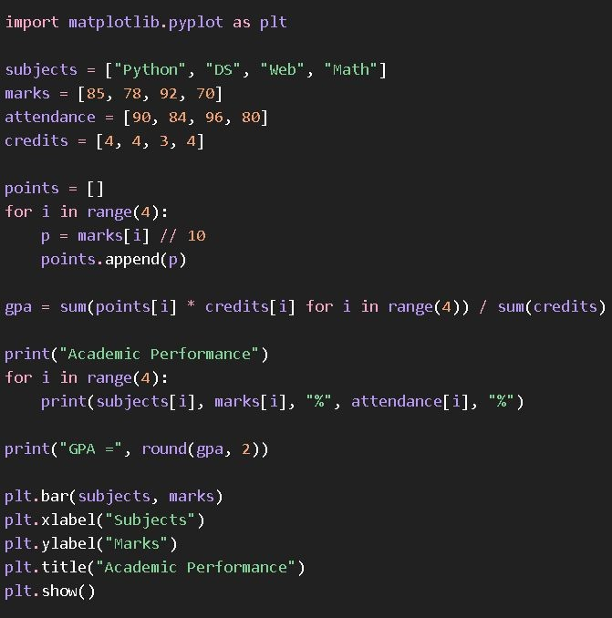
5. Understanding of Python Logic

Slide 8
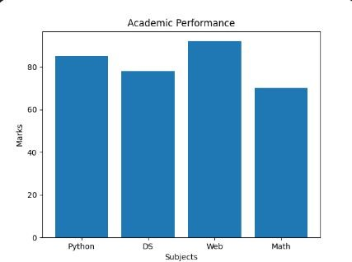
6. Graphical Representation and Working
Working: Input → validation → grade calculation → GPA/CGPA calculation → attendance analysis → chart generation
→ final academic dashboard.
Illustrative values demonstrate the intended visualization.

Slide 9
7. GitHub Account, Repository & Collaboration
Create GitHub Account – Set up a personal GitHub account. Create Repository – Intelligent Academic Performance Tracker & Visualizer.
Upload Code – Upload the Python source code, requirements, and README.
Meaningful Commits – Save changes with clear messages such as “Added GPA calculation” or “Added charts”.
Collaboration – For teamwork, use repository sharing, branches, or pull requests.
Individual Contribution – Each member contributes and commits their work.
Track Changes – Use GitHub to manage versions, issues, and project updates.

Slide 10
8. Individual Contribution
Problem Analysis – Identified the need for an automated academic performance tracker.
Data Design – Planned the structure for subjects, marks, credits, attendance, and semesters.
Python Coding – Implemented input handling, grading logic, GPA/CGPA calculations, and validation.
Visualization – Created subject-wise performance and semester trend charts.
Testing – Tested calculations using different marks, credits, and attendance values.
GitHub Contribution – Uploaded code and made meaningful commits.
Documentation & PPT – Prepared project documentation and presentation slides.

Slide 11
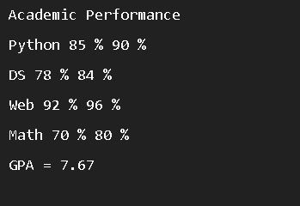
9. Result / Expected Output

Slide 12
1. Phase 2
Phase 1 recap
Problem: manually calculating grades, GPA/CGPA and attendance is slow and error-prone.
Objective: a Python application that calculates results and visualizes academic performance.
Phase 1 completed: problem statement, algorithm, flowchart, Python logic, sample chart and GitHub repository.
Phase 2 focus: working modules, code implementation, visualization output and GitHub collaboration.

Slide 13
2. Project Progress (Work Done ~70%)
Module | Work Done | Status
Input & Validation | Student, marks, credits and attendance entry with range checks | Completed
Grade & GPA Engine | Grades, grade points, semester GPA and CGPA | Completed
Attendance Analysis | Attendance % and eligibility status per subject | Completed
Visualization | Subject-wise bar chart and semester GPA trend | Completed
Data Storage | Saving and loading academic records in CSV files | In Progress
Summary Report | Final dashboard and report export | Pending

Slide 14
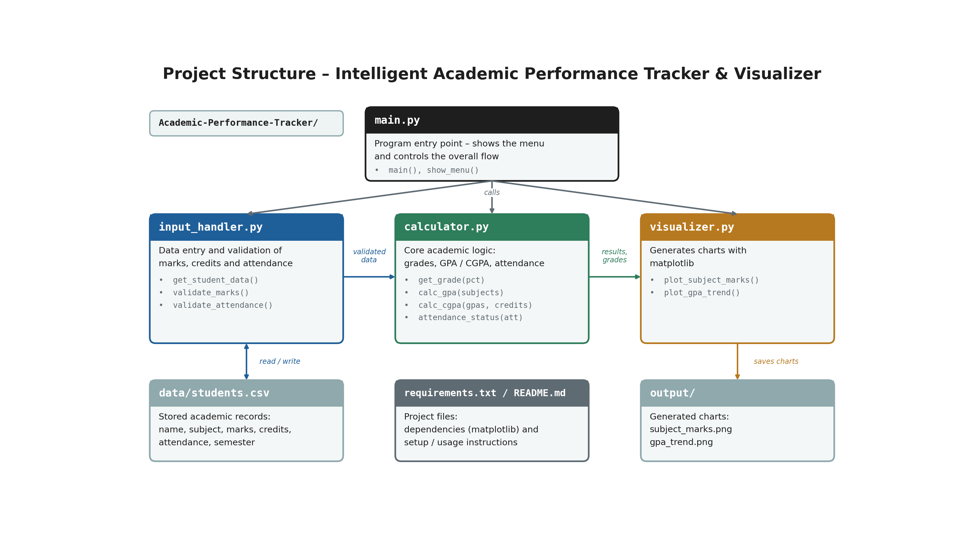
3. Project Structure
Modular design: each file has one responsibility, which makes testing and collaboration easier.

Slide 15
4. Testing, Challenges & Next Steps
Testing done so far
GPA/CGPA checked against manual calculations with different marks and credits.
Invalid inputs (negative marks, attendance above 100) handled by validation.
Challenges faced
Handling different credit values while computing weighted GPA and CGPA.
Phase 3 plan
Finish CSV storage and report export, complete final testing and deploy the project.

Slide 16
Thank You
Intelligent Academic Performance Tracker & Visualizer

